Slide 1
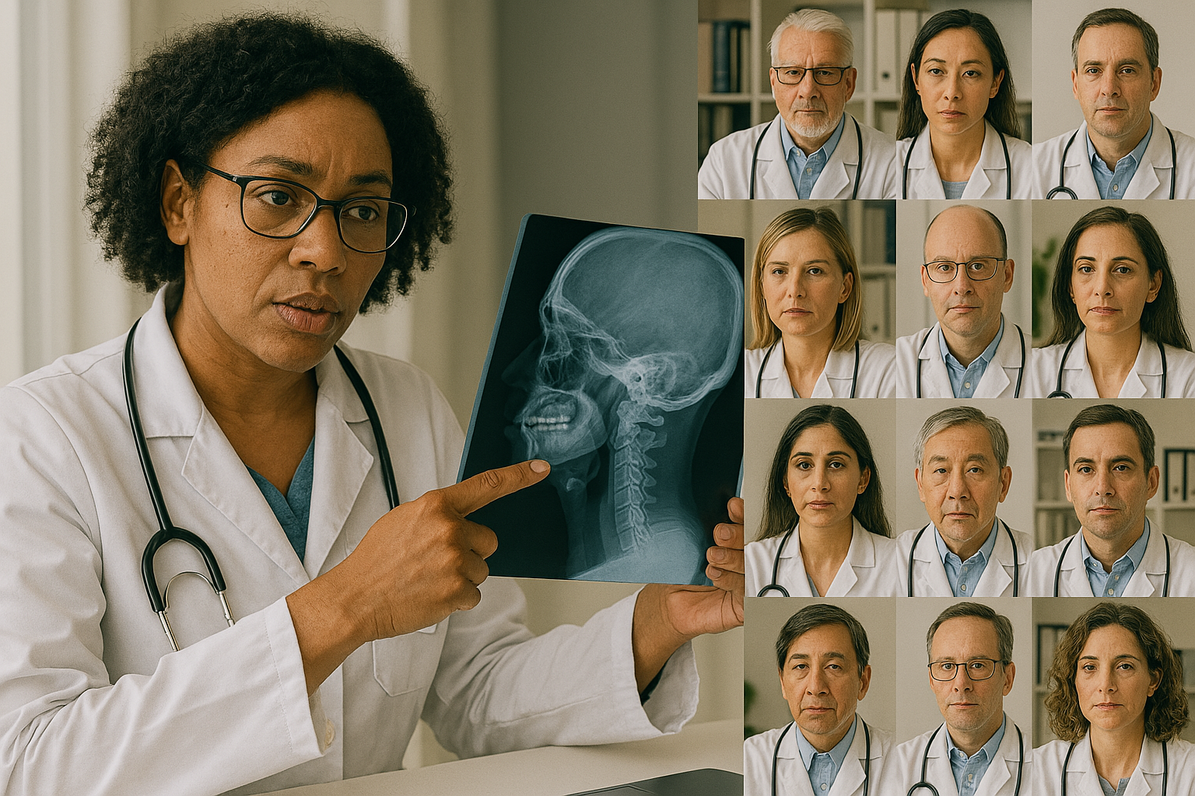
European FA Virtual Tumor Advisory Board
Bob Dalgleish

Slide 2
The Need for a Virtual Tumor Board
FA Europe’s vision is for harmonised care across Europe
Head and Neck Cancers now more prevalent with increasing numbers of FA adult patients
Limited experience of treating FA patients for these types of cancers across Europe
Want to centralise and improve management of cancer by providing structured case discussions and harmonised expert advice across Europe for physicians treating FA patients with head and neck cancers
Fundamentally we want to improve outcomes for our growing adult FA community

Slide 3
VTAB Platform Options
Fanconi Cancer Foundation Virtual Tumor Board
Available to Clinicians and Families worldwide
Zoom-based
All cancers discussed
Late 2020 till now - 56 cases
Time zones problematic
European Reference Networks Clinical Patient Management System
Fully GDPR compliant IT platform
Can submit Dicom Imagery
CPMS 1.0 was complex & time-consuming to join
CPMS 2.0 not known, but reference manual is 166pp
EU Member Countries only
FA Europe Virtual Tumor Advisory Board
Start simple!
Zoom-based monthly meetings
Head and Neck Cancer Cases only at this stage
Physician Requests only
Moderated by Dr Eunike Vellueur-Carlberg
FA Europe Management Team Support

Slide 4
VTAB - How it Works
Presenting Physician
Moderator
Tumor Board
Moderator
Moderator & Physician
Download request form from www.faeurope.org/favtab
Complete form and obtain patient consent for use of pseudonymised data. Email to Moderator
Moderator reviews and shares form with VTAB members
Case discussed in monthly VTAB meeting
Advice summary sent back to physician
6 month follow-up
Meetings held on the last Tuesday of each month at 19:00 CET

Slide 5
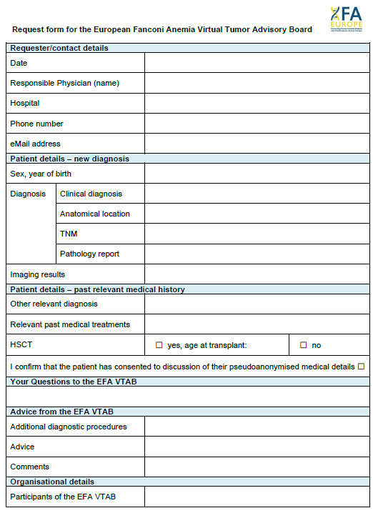
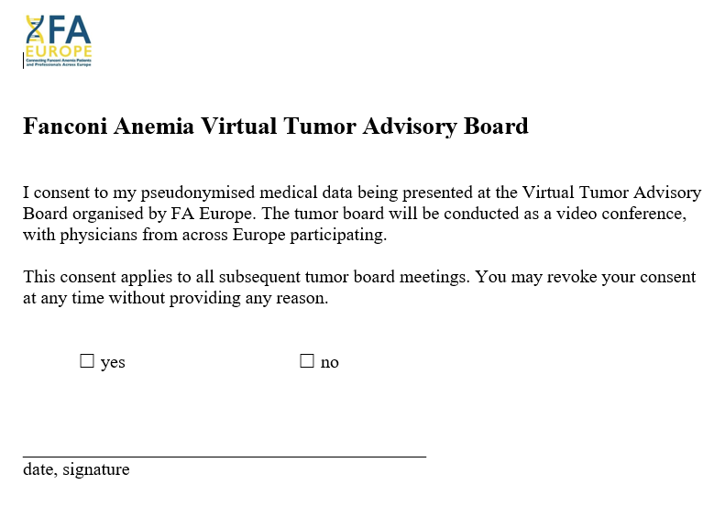
Request and Consent Forms

Slide 6
Joining the VTAB
FA VTAB Applicant
Moderator
FA Europe Admin
Go to www.faeurope.org/favtab
Complete the online form and sign confidentiality statement. Submit online
Apply to Join the FA VTAB
Moderator reviews/ approves application
Monthly meeting invitation sent out

Slide 7
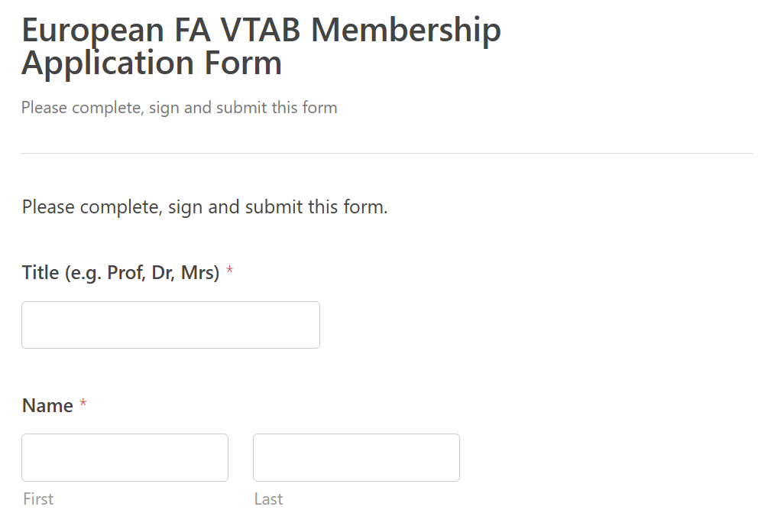
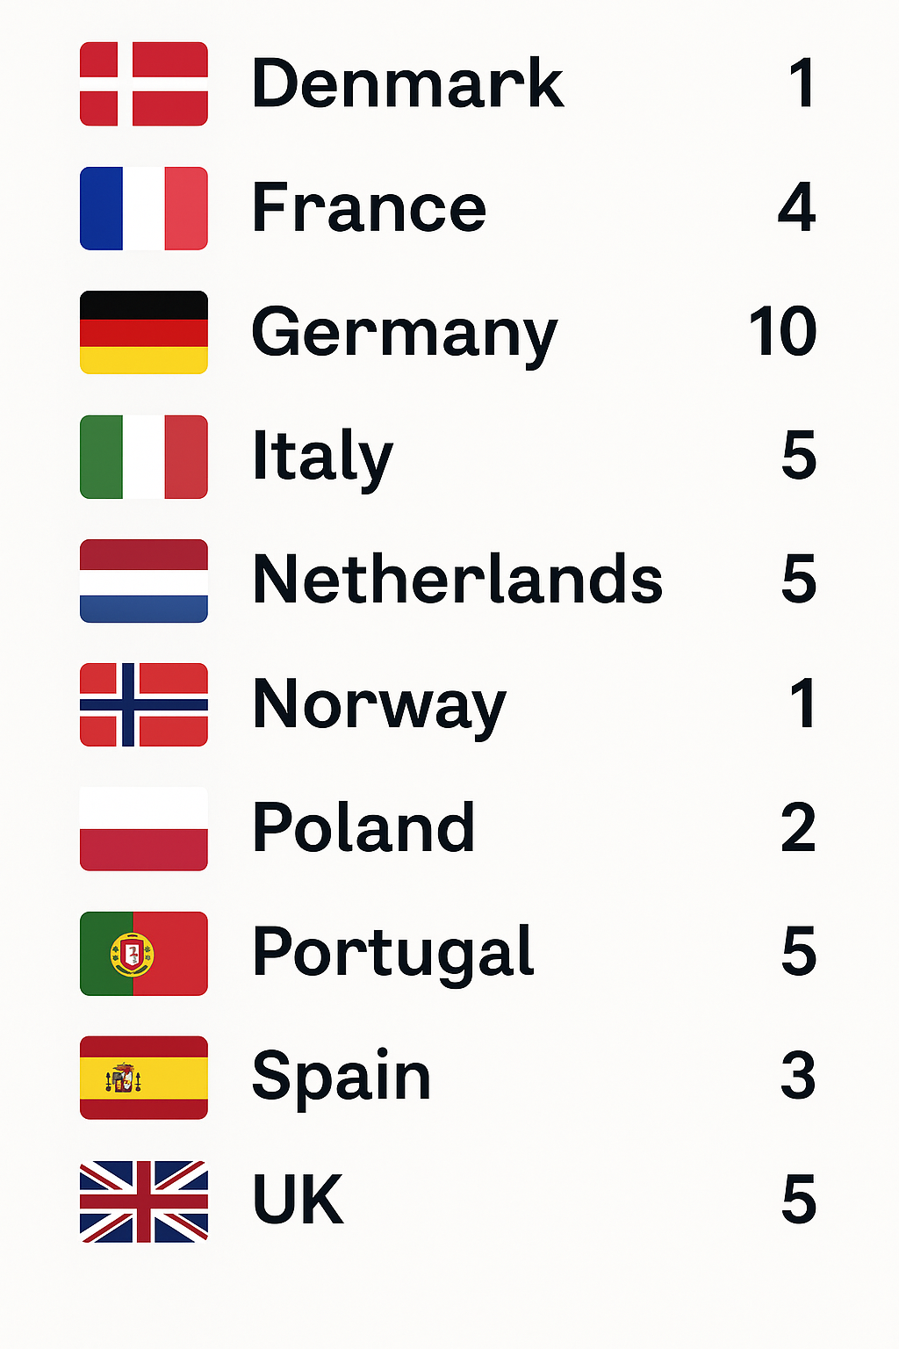
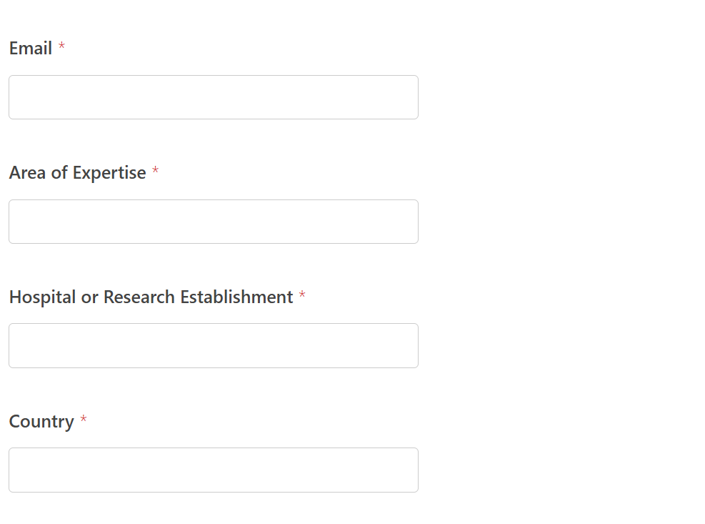
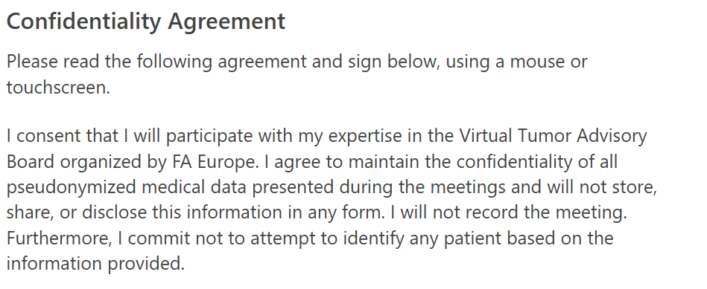
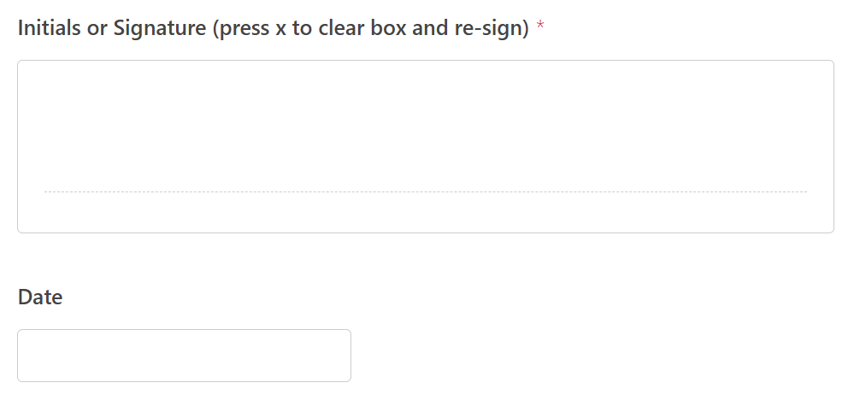
VTAB Application Form
Total FA VTAB Members 41
But not everyone is an expert!
Submit

Slide 8
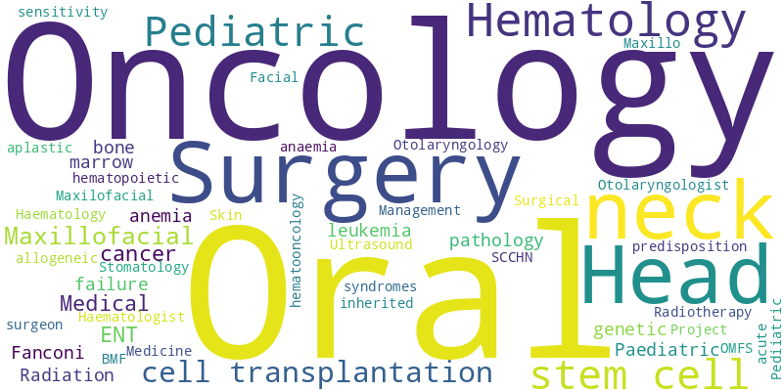
Expertise areas

Slide 9
VTAB Meeting Feedback
Meeting Date | Attendees | Cases | Feedback
Jan 25 | 24 | 1 | A great success. Very lively, active, patient-orientated and very fruitful discussion The local treating physician was incredibly grateful
Feb 25 | 11 | 1 | Very dynamic discussion. Identified a specific clinical aspect of which the treating physician was unaware, so another very fruitful meeting
Mar 25 | 14 | 2 | Two cases for the first time submitted without encouragement form the VTAB team
Apr 25 | 10 | 1 | A physician returned to present his second case – so both a satisfied customer and earlier VTAB engagement in the clinical agenda of the patient as a result.
Conclusions so far:
Viable working Tumor Advisory Board, getting excellent feedback from presenting physicians
Starting to help improve patients outcomes, with more standardised treatment advice
Educating fellow physicians in the VTAB and building up a consensus-based knowledge base

Slide 10
Future Developments
Integration with
Fanconi Cancer Foundation VTB
Tissue Banking Facility
Develop Database for Research and Learning
Expand range of Cancers
Head and Neck Cancer Cases only
More capable and secure platform search

Slide 11
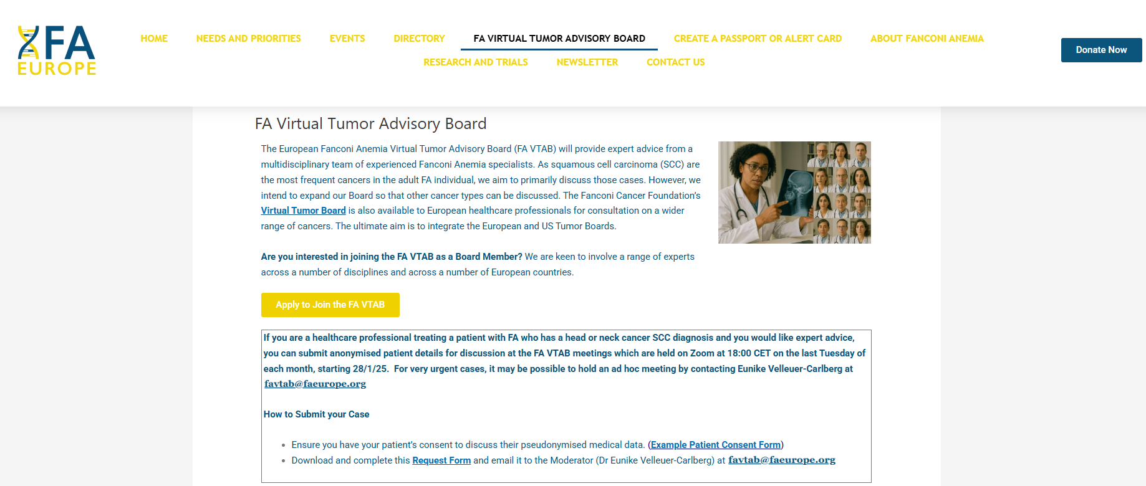
Thanks To:
The Core Group involved with this initiative:
Eunike Velleuer-Carlberg
Christine Krieg
Arnauld Beddok
Juliette Thariat
Charles Bichet
Samir Aiddouch
The 41 experts who have given their time freely to be on the Tumor Advisory Board
www.faeurope.org/favtab
Join the European FA VTAB!

